Slide 1
Student Analytics: Integrated Academic Dashboards
Nkosinathi Hlongwane

Slide 2
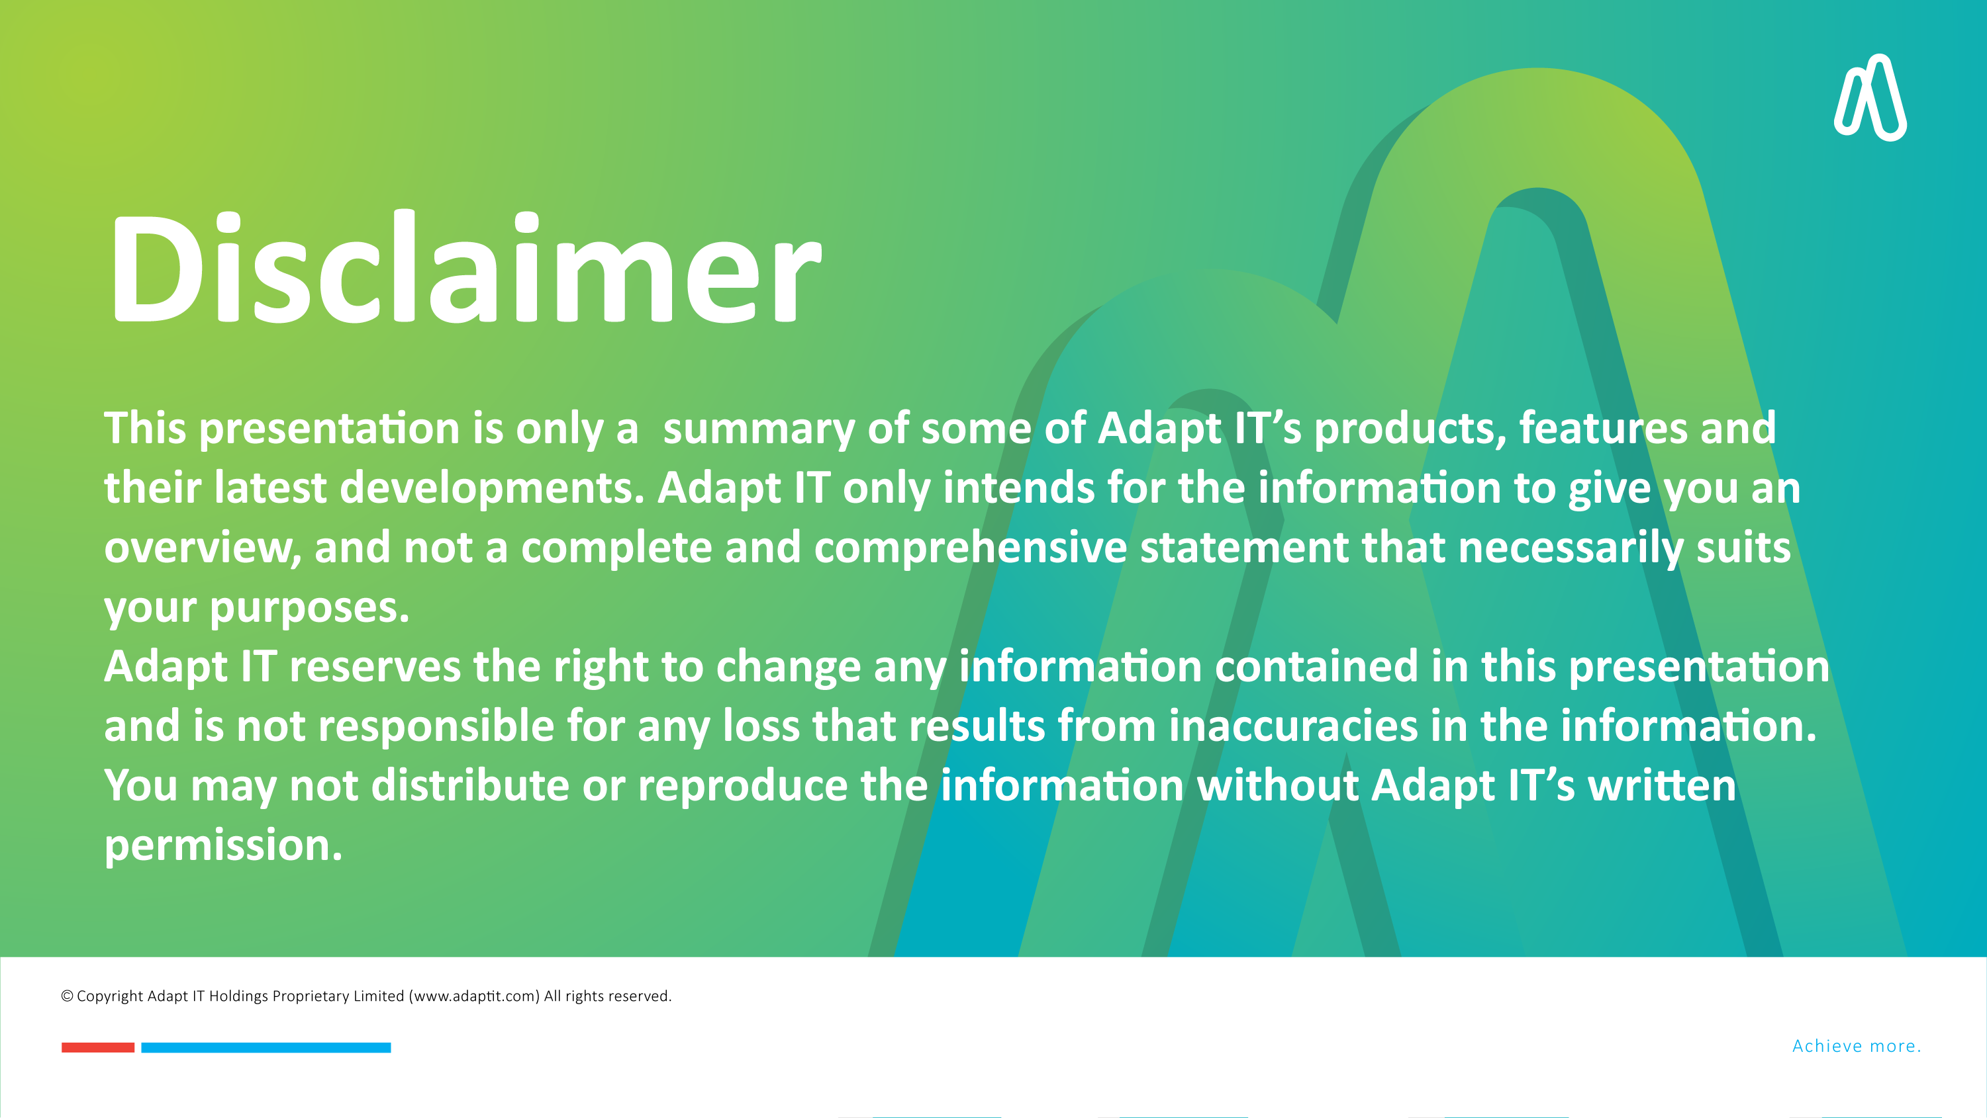

DISCLAIMER
This presentation is only a summary of some of Adapt IT’s products, features and their latest developments. Adapt IT only intends for the information to give you an overview, and not a complete and comprehensive statement that necessarily suits your purposes.
Adapt IT reserves the right to change any information contained in this presentation and is not responsible for any loss that results from inaccuracies in the information. You may not distribute or reproduce the information without Adapt IT’s written permission.

Slide 3

Key stakeholders
Benefits and advantages
Value Proposition
Integrated student academic analytics items
Examples of the proposed data analytics
Data presentation tools
Table of contents

Slide 4
Key Stakeholders

Slide 5
Key stakeholders and audience
Department HOD
Registrar
Academics
Dean
Vice Chancellor
CFO
Administrators

Slide 6
Benefits and advantages

Slide 7
Benefits and advantages
Informed decisions
Synergy
Efficiency
Risk management
Continuous monitoring
Data-driven insights
Real-time

Slide 8
Value Proposition

Slide 9
Value Proposition
Targeted interventions for at-risk students to improve engagement and success
Automation and accuracy in operational and compliance reporting, reducing administrative burden.
Real-time financial insights for better budgeting, planning, and audit readiness.
Predictive analytics for proactive decision-making and strategic planning
1. Assignment contents
2. Instructions
3. Attach guidelines (Rubric)

Slide 10
Integrated Student Academic analytics items

Slide 11
Integrated Student Academic analytics items
Comprehensive Analytics Suite for Education using student’s ITS and Moodle data
Centralised data store for operational reporting
Student’s Financial data reporting
Predictive analytics
(dropout predictor)
Student Portfolio builder
ITS (Biography)
Moodle
(Academic Record )
Funding information
Tuition fees records
Administrative reports
Student performance monitor
ITS & Moodle data integrated to form centralized reporting
Academic exclusion
Financial exclusion
Student qualification and module enrolment info
1. Evaluation score
2. Total score
3. Overall analysis

Slide 12
Examples of the proposed Data Analytics

Slide 13
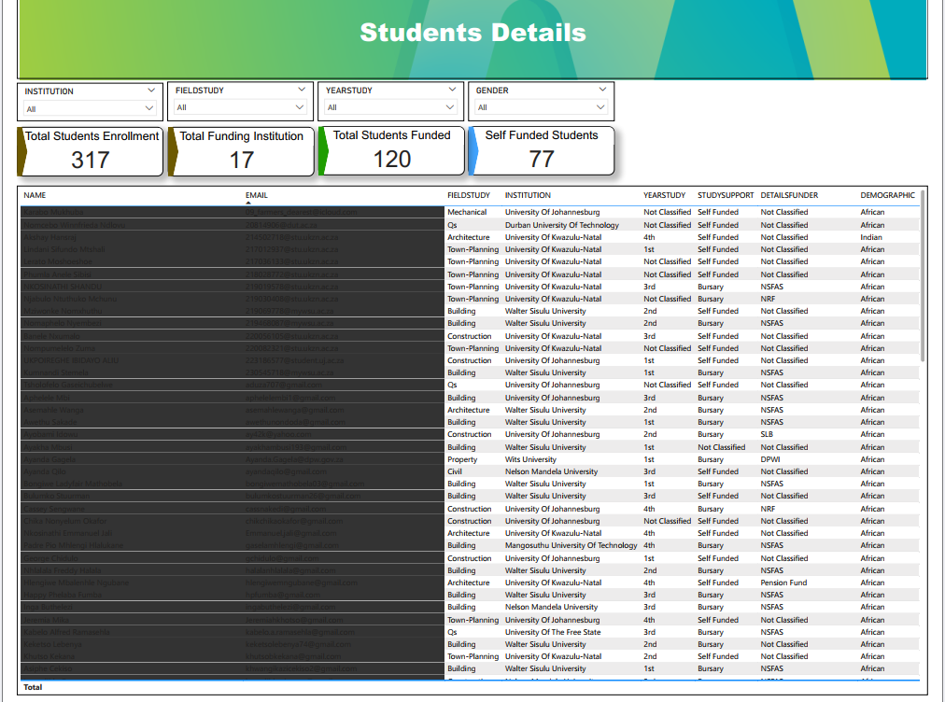

Slide 14
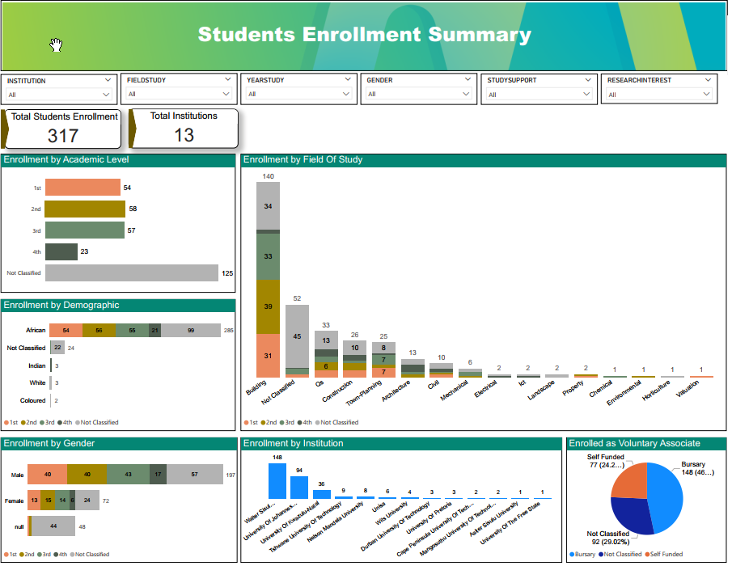

Slide 15
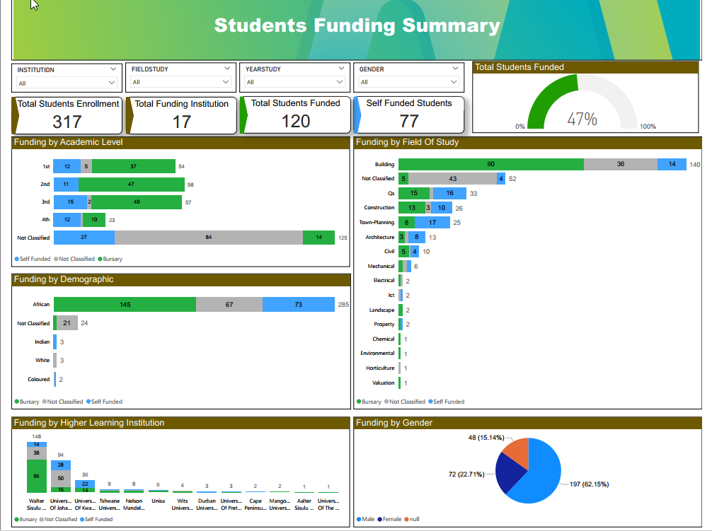

Slide 16
Data presentation tools

Slide 17



Proposed data presentation tool’s
Visualised Power BI Dashboards
Presented user interface with Downloadable tabulated reports in excel
Exportable dashboards into PDF

Slide 18



